Slide 1
Node.js
Mohamed Omran Senior Software Engineer @The Fabulous

Slide 2


Slide 3


Slide 4
Tips:
Early return
Object vs if vs switch

Slide 5
Reference mutation
Im/pure Functions

Slide 6
Build custom Module
How require works?
Order of require
Require folder
Require json/js
5 global variables
Native modules
Custom modules
Caching
Read about ESM, how, pros, why they chose it over CJS (Lab requirement)
Read about circular dependency (Lab requirement)

Slide 7
NPM
package.json
Package-lock.json
Sem-Ver

Slide 8
Web 101
Web Server from beginning
Protocols
HTTP
Meaning
Request
Response
Stateless
Methods
Status codes

Slide 9
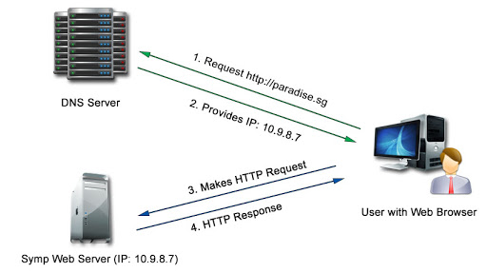
Web 101

Slide 10
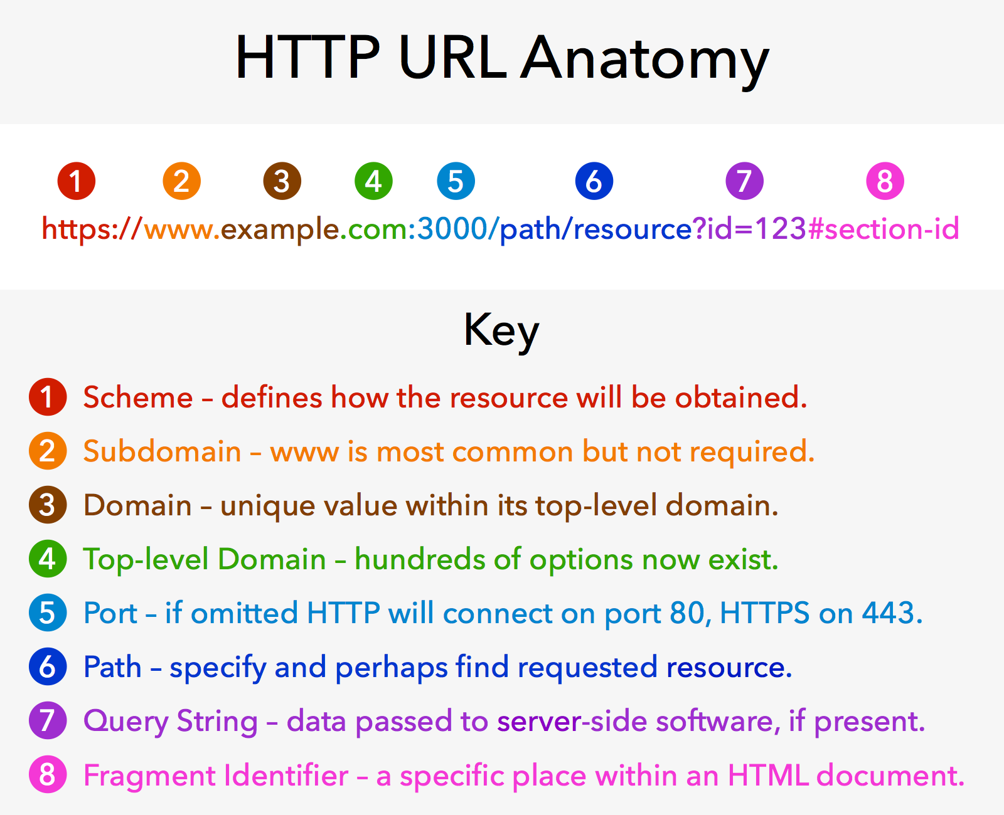
Web 101

Slide 11

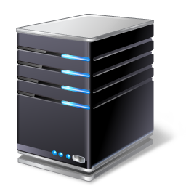


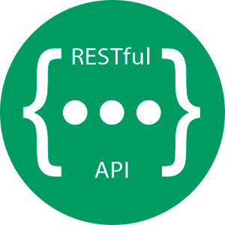

DBMS
(1) HTTP Request
Requests
File System
Web Server
(6) Fetched data
OS
(7) HTTP Response
Application Server (express)
Other Sources

Slide 12
What is a web application?
Listen => Request => Route => Logic => Response

Slide 13
HTTP module

Slide 14
Streams

Slide 15
debugger;

Slide 16
linter;

Slide 17
Express.js
Server
Routing (patterns, params, query, postman)
Middlewares (app, route[ ], built-in, custom)
RESTful API (body)
Static Files
Views (SSR)

